Slide 1



Noida Institute of Engineering and Technology, Greater Noida
IoT PROTOCOLS & ITS APPLICATIONS
Unit: 1
INTRODUCTION
Mr. Amit Kumar
Asst. Professor
CSE-IoT Department
B Tech (CSE-IoT)
6th Sem

Slide 2



Brief Introduction of Faculty
Amit Kumar received his B.E degree in Electronics and Communication Engineering from Hindustan College of Science and Technology, Mathura, M.Tech degree in VLSI design from AKTU Lucknow. His major areas of research work include Wireless Communication. He has pursued his Ph.D in Wireless Communication from NIT Patna. He has more than 20 years of teaching experience.

Slide 3

Evaluation Scheme
1/5/2024
3
Notes:
3

Slide 4
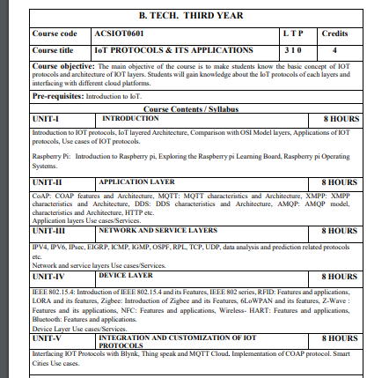
Subject Syllabus
1/5/2024
4
Notes:
4

Slide 5
Unit Syllabus
UNIT-I INTRODUCTION
Introduction to IOT protocols, IoT layered Architecture, Comparison with OSI Model layers, Applications of
IOT protocols, Use cases of IOT protocols.
Raspberry Pi: Introduction to Raspberry pi, Exploring the Raspberry pi Learning Board, Raspberry pi
Operating Systems.
1/5/2024
5
Notes:
5

Slide 6
Branch wise Applications
Electronics Engineering
Home Automation
Improving Security
Instructing Solar Panels
Microcontrollers
Civil Engineering:
Preventive Maintenance Programs
Real-Time Construction Management Solution
Automated documentation
Workers’ safety
Decision Making
Biomedical Engineering:
Wearable devices and IoT
Superlative Care
Faster Disease Diagnosis
Lesser stay in hospital

Slide 7
Course Objective
Student will learn about:
The architectural overview and IoT reference architecture.
Open source architecture and design principles.
The various types of IoT connectivity protocols.
Different types of IoT layered protocols.
Differences between Web of things and Internet of things.

Slide 8
Course Outcome
After completion of this course students will be able to:
CO 1 Identifying the essentials of IOT protocols. K1
CO 2 Articulate Application layer protocols. K3
CO 3 Tagging Network and service layer protocols. K2
CO 4 Understand the concepts of Device layer protocols. K2
CO 5 Build IoT-based smart systems for real-world problems using IOT K6

Slide 9
Program Outcomes
Program Outcomes are narrow statements that describe what the students are expected to know and would be able to do upon the graduation.
These relate to the skills, knowledge, and behavior that students acquire through the programmed.
Engineering knowledge
Problem analysis
Design/development of solutions
Conduct investigations of complex problems
Modern tool usage
The engineer and society
Environment and sustainability
Ethics
Individual and team work
Communication
Project management and finance
Life-long learning

Slide 10
CO-PO Mapping
 |  | IoT PROTOCOLS & ITS APPLICATIONS
CO | PO1 | PO2 | PO3 | PO4 | PO5 | PO6 | PO7 | PO8 | PO9 | PO 10 | PO 11 | PO 12
CO1 | 3 | 2 | 1 | 1 | 1 | 1 | 1 | - | 1 | 1 | 1 | 2
CO2 | 2 | 2 | 2 | 2 | 1 | 1 | - | 1 | 1 | 1 | 1 | 2
CO3 | 3 | 2 | 2 | 1 | 2 | 2 | 1 | 1 | 2 | 2 | 1 | 2
CO4 | 3 | 2 | 2 | 2 | 2 | 1 | 1 | - | 1 | 1 | 1 | 2
CO5 | 2 | 2 | 2 | 1 | 2 | - | 1 | - | 1 | 2 | 2 | 2
Average | 2.6 | 2 | 1.8 | 1.4 | 1.6 | 1 | 0.8 | 0.4 | 1.2 | 1.4 | 1.2 | 2

Slide 11

Program Specific Outcomes
S.NO. | PSO | PSO Description
1 | PSO1 | Apply concept of IoT to solve real world problems for societal wellbeing by leveraging latest tools.
2 | PSO2 | Work as an individual or lead as a team with good communication and engage in life-long learning.
3 | PSO3 | Apply ethical principles as a successful professional, entrepreneur, and pursue higher education.
1/5/2024
11
Notes:
11

Slide 12
Program Educational Objectives
Engage in designing, manufacturing/fabricating, and maintaining smart systems in the field of IoT.
Solve problems of social relevance through applying the knowledge of basic science, IoT and pursue higher education and research.
Engage in life-long learning, career enhancement, and be able to adapt to dynamic needs of profession and society.
Work as an individual and as a team member in multidisciplinary projects with effective communication.
1/5/2024
12
Notes:
12

Slide 13
Prerequisite and Recap
Basics of Internet of Things
Concept of Networking
Different types of IoT Architectures

Slide 14
Brief Introduction about Subject
The Internet of Things is an emerging subject of technical, social, and economic significance, which has its application enormously increased in the past few years, it has a vast scope of usage.
IoT generally refers to a growing network of internet-connected devices that find various applications in engineering and sciences. When objects are interconnected across the world it allows people or things using those objects to be connected anytime. Connected things shall ease human life. As an example from urban transport to medical devices, home electronics and appliances to cars, heart monitoring implants and many more.
Video Link:
https://www.youtube.com/watch?v=O--rkQNKqls&list=PLEAYkSg4uSQ2NMmzNNsEK5RVbhxqx0BZF

Slide 15
Unit Content
Introduction to IOT protocols,
IoT layered Architecture,
Comparison with OSI Model layers,
Applications of IOT protocols,
Use cases of IOT protocols.
Raspberry Pi: Introduction to Raspberry pi,
Exploring the Raspberry pi Learning Board, Raspberry pi
Operating Systems.

Slide 16
Unit Objective
Student will learn about the various types of IoT connectivity protocols.

Slide 17
Introduction to Topic 1
Name of Topic | Objective of Topic | Mapping with CO
IoT Connectivity Overview | Students will be able to learn about basic concept of IoT coonectivity. | CO3

Slide 18
IoT Connectivity
IoT connectivity is a term defining connection between all the points in the IoT ecosystem, such as sensors, gateways, routers, applications, platforms and other systems.
It usually refers to different types of network solutions based on their power consumption, range and bandwidth consumption.
IoT projects vary in their requirements and many of them use different connectivity options depending on their needs.
The Connectivity is a critical component of the Internet of Things.
IoT manufacturers have a wide range of options when it comes to connectivity. But they’re not all the same. Some connectivity solutions weren’t designed for the Internet of Things and have limited use cases. Others were specially designed for specific types of IoT applications and scenarios.

Slide 19
IoT Connectivity
IoT connectivity solutions:
Cellular
Bluetooth
Zigbee
LoRaWAN
Ethernet
RFID
BLE
NFC
Z-wave
Li-Fi
Power Line Communication (PLC)
Meter Bus (M-bus) and wireless M-bus

Slide 20
IoT Connectivity
How to compare IoT connectivity solutions?
Coverage
One of the most crucial factors to consider when selecting a connectivity solution is coverage: will it work where your devices need to deploy?
Bandwidth
Bandwidth is the network’s maximum capacity for transmitting data.
Data throughput
Bandwidth represents a network’s capacity. Data throughput represents the speed at which it can transfer data.
Mobility
Some IoT devices such as car entertainment systems, self-driving cars, and tracking devices need to receive and transmit data while moving at high speeds. If your application has a mobile element, you need to look for connectivity solutions that can handle this sort of data transfer.

Slide 21
IoT Connectivity
Latency
Latency is the delay between when data is sent and when it is received.
Indoor penetration
Some signals are stronger than others. For devices that are typically deployed underground or in dense buildings, you’ll need to think about how well the signal penetrates these obstructions. Generally, lower frequency signals have better indoor penetration.
Security
Redundancy
Network redundancy is so valuable: it ensures that you always have a backup connectivity system in place.

Slide 22
Daily Quiz
1. What is the standard form of RFID?
Radio Frequency Identification
Radio Frequency-Independent
Radio Frequency-Dependent
None of the above
2. The RFID tags consists of an _______
Antenna
Integrated circuit
Both a and b
None of the above

Slide 23
Daily Quiz
3. The Bluetooth technology operates in the ISM band at _________
2.4 to 2.485 GHz
1.4 to 2.485 GHz
2.4 to 2.485 MHz
None of the above
4. The Z-waves uses radiofrequency for _______
Control
Signalling
Both a and b
None of the above

Slide 24
Daily Quiz
5. The communication range in NFC is __________
<20cms
>20cms
>40cms
>60cms
6. The NFC transmits data at a rate of ____________
212 Kbps
106 Kbps
424 Kbps
Either 212, 1106, 424 Kbps

Slide 25
Recap
IoT connectivity is a term defining connection between all the points in the IoT ecosystem, such as sensors, gateways, routers, applications, platforms and other systems.
The major IoT Communication technologies are: Bluetooth, BLE, Zigbee, Z-wave, RFID, NFC, WIFI, LIFI.

Slide 26
Introduction to Topic 2
Name of Topic | Objective of Topic | Mapping with CO
Wireless Long Range (WAN) Protocol | Students will be able to learn about WAN protocols used for IoT connectivity | CO3

Slide 27
WAN Protocols
WAN protocols are distinguished by their capability to efficiently deliver data over longer distances, such as hundreds of miles. This is generally required to bridge data between multiple LANs.
The Internet is the world's largest WAN.
Routers, modems and other WAN devices are used to transmit the data over various mediums, commonly fiber cabling.
Some of the most common WAN protocols in use today are:
Frame Relay
X.25
Integrated Services Digital Network (ISDN)
Point-to-Point Protocol (PPP)
HDLC
SDLC
Notes:
https://netcert.tripod.com/ccna/wan/wan.html
https://www.techwalla.com/articles/wanlan-protocols

Slide 28
WAN Protocols
X.25:
X.25 is a protocol suite defined by ITU-T for packet switched communications over WAN (Wide Area Network). It was originally designed for use in the 1970s and became very popular in 1980s. Presently, it is used for networks for ATMs and credit card verification. It allows multiple logical channels to use the same physical line. It also permits data exchange between terminals with different communication speeds.
X.25 has three protocol layers
Physical Layer
Data Link Layer
Packet Layer
Notes:
https://www.tutorialspoint.com/X-25-and-Frame-Relay

Slide 29
WAN Protocols
Frame relay:
Frame Relay is a packet switched communication service from LANs (Local Area Network) to backbone networks and WANs.
It operates at two layers: physical layer and data link layer.
It supports all standard physical layer protocols.
It is mostly implemented at the data link layer.
Frame Relay uses virtual circuits to connect a single router to multiple remote sites.
Frame relay is a fast packet technology based on X.25. Data is transmitted by encapsulating them in multiple sized frames.
The protocol does not attempt to correct errors and so it is faster. Error correction is handled by the endpoints, which are responsible for retransmission of dropped frames.
Notes:
https://sumatosoft.com/blog/internet-of-things-design-how-to-build-principles-with-examples
https://www.forbes.com/sites/forbestechcouncil/2020/12/01/nine-architectural-principles-to-consider-before-building-an-iot-platform/?sh=5bb496672278
https://www.i-scoop.eu/internet-of-things-iot/iot-platform-market-2017-2025/

Slide 30
WAN Protocols
ISDN:
Integrated Services Digital Network is a set of digital services that transmit voice and data over existing phone lines.
ISDN can offer a cost-effective solution for remote users who need a higher-speed connection than an analog dial-up link offers.
ISDN is also a good choice as a backup link for other types of links such as Frame Relay or a T-1 connection.
ISDN is a method of combining multiple dial-up lines on a public telephone network into a single data stream.
Notes:
https://netcert.tripod.com/ccna/wan/wan.html

Slide 31
WAN Protocols
HDLC:
High-Level Data Link Control was derived from Synchronous Data Link Control (SDLC), which was created by IBM as a Data Link connection protocol.
HDLC is a connection-oriented protocol at the Data Link layer, but it has very little overhead compared to LAPB.
HDLC was not intended to encapsulate multiple Network layer protocols across the same link.
The HDLC header carries no identification of the type of protocol being carried inside the HDLC encapsulation.
Because of this, each vendor that uses HDLC has their own way of identifying the Network layer protocol, which means that each vendor's HDLC is proprietarty for their equipment.
Notes:
https://sumatosoft.com/blog/internet-of-things-design-how-to-build-principles-with-examples
https://www.forbes.com/sites/forbestechcouncil/2020/12/01/nine-architectural-principles-to-consider-before-building-an-iot-platform/?sh=5bb496672278
https://www.i-scoop.eu/internet-of-things-iot/iot-platform-market-2017-2025/

Slide 32
WAN Protocols
PPP:
Point-to-Point protocol is an industry standard protocol.
Because many versions of HDLC are proprietary, PPP can be used to create point-to-point links between different vendor's equipment.
It uses a Network Control Protocol field in the Data Link header to identify the Network layer protocol.
It allows authentication and multilink connections and can be run over asynchronous and synchronous links.
SDLC:
Synchronous Data Link Control. SNA data link layer communications protocol.
SDLC is a bit-oriented, full-duplex serial protocol that has spawned numerous protocols, including HDLC and LAPB.
Notes:
https://sumatosoft.com/blog/internet-of-things-design-how-to-build-principles-with-examples
https://www.forbes.com/sites/forbestechcouncil/2020/12/01/nine-architectural-principles-to-consider-before-building-an-iot-platform/?sh=5bb496672278
https://www.i-scoop.eu/internet-of-things-iot/iot-platform-market-2017-2025/

Slide 33
Daily Quiz
Frame Relay is cheaper than other _____.
LANs
WANs
MANs
Multipoint Networks
2. Frame Relay networks offer an option called _______.
Voice Over For Relay
Voice Over Fine Relayc
Voice On Frame Relay
Voice Over Frame Relay

Slide 34
Daily Quiz
3. X.25 is a ______ protocol.
LAN
WAN
MAN
None of the above
4. X.25 has _____ layers.
2
3
4
5
Which Layer 2 protocol encapsulation type supports synchronous and asynchronous circuits and has built-in security mechanisms?A. HDLCB. PPPC. X.25D. Frame Relay

Slide 35
Daily Quiz
5. Which Layer 2 protocol encapsulation type supports synchronous and asynchronous circuits and has built-in security mechanisms?
HDLC
PPP
X.25
Frame Relay
6. Identify 3 characteristics of ISDN?
Transports voice and data.
Transports voice only
Support both BRI and PRI
Runs over existing phone lines.
Same as X.25

Slide 36
Recap
WAN protocols are distinguished by their capability to efficiently deliver data over longer distances, such as hundreds of miles. This is generally required to bridge data between multiple LANs.
The Internet is the world's largest WAN.
Some of the most common WAN protocols in use today are: Frame Relay, X.25, Integrated Services Digital Network (ISDN), Point-to-Point Protocol (PPP), HDLC and SDLC

Slide 37
Introduction to Topic 3
Name of Topic | Objective of Topic | Mapping with CO
LAN protocols | Students will be able to learn about the LAN protocols used ifor IoT connectivity. | CO3
Notes:
https://iotnotesbyparita.wordpress.com/iot-reference-architecture/

Slide 38
LAN Protocols
LAN protocols are distinguished by their capability to efficiently deliver data over shorter distances, such as a few hundred feet, through various mediums, such as copper cabling.
Different protocols exist for different purposes and exist in different "layers" of the "Open Systems Interconnect," or OSI, model.
Typically when using the word "LAN" to describe a protocol, the intent is to describe lower level, or physical, layers.
Some of the most common LAN protocols are:
Ethernet
Token Ring
Fiber Distributed Data Interface (FDDI)
Notes:
https://www.techwalla.com/articles/wanlan-protocols

Slide 39
LAN Protocols
Ethernet/ IEEE 802.3:
Ethernet is a set of technologies and protocols that are used primarily in LANs. It was first standardized in 1980s by IEEE 802.3 standard.
Ethernet is classified into two categories:
Classic Ethernet: Classic Ethernet is the original form of Ethernet that provides data rates between 3 to 10 Mbps. The varieties are commonly referred as 10BASE-X. Here, 10 is the maximum throughput, i.e. 10 Mbps, BASE denoted use of baseband transmission, and X is the type of medium used. Most varieties of classic Ethernet have become obsolete in present communication scenario.
Switched Ethernet: A switched Ethernet uses switches to connect to the stations in the LAN. It replaces the repeaters used in classic Ethernet and allows full bandwidth utilization.
Notes:
https://www.techwalla.com/articles/wanlan-protocols

Slide 40
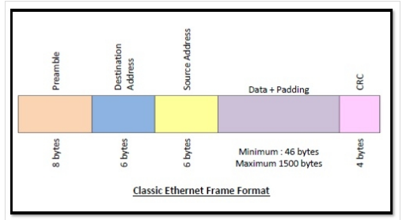
LAN Protocols
Notes:
https://www.techwalla.com/articles/wanlan-protocols

Slide 41
LAN Protocols
Frame Format of Classic Ethernet and IEEE 802.3
Preamble: It is the starting field that provides alert and timing pulse for transmission. In case of classic Ethernet it is an 8 byte field and in case of IEEE 802.3 it is of 7 bytes.
Start of Frame Delimiter: It is a 1 byte field in a IEEE 802.3 frame that contains an alternating pattern of ones and zeros ending with two ones.
Destination Address: It is a 6 byte field containing physical address of destination stations.
Source Address: It is a 6 byte field containing the physical address of the sending station.
Length: It a 7 bytes field that stores the number of bytes in the data field.
Data: This is a variable sized field carries the data from the upper layers. The maximum size of data field is 1500 bytes.
Padding: This is added to the data to bring its length to the minimum requirement of 46 bytes.
CRC: CRC stands for cyclic redundancy check.
Notes:
https://www.techwalla.com/articles/wanlan-protocols

Slide 42
LAN Protocols
Token Ring/ IEEE 802.5
Token ring (IEEE 802.5) is a communication protocol in a local area network (LAN) where all stations are connected in a ring topology and pass one or more tokens for channel acquisition.
A token is a special frame of 3 bytes that circulates along the ring of stations. A station can send data frames only if it holds a token.
The tokens are released on successful receipt of the data frame.
Token Passing Mechanism in Token Ring
If a station has a frame to transmit when it receives a token, it sends the frame and then passes the token to the next station; otherwise it simply passes the token to the next station.
Passing the token means receiving the token from the preceding station and transmitting to the successor station.
Notes:
https://www.techwalla.com/articles/wanlan-protocols

Slide 43
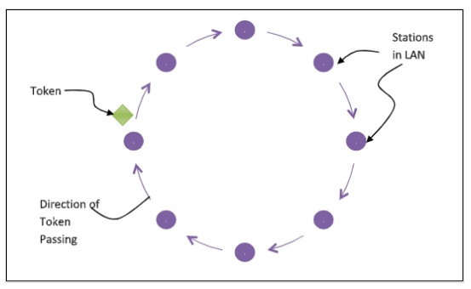
LAN Protocols
The data flow is unidirectional in the direction of the token passing. In order that tokens are not circulated infinitely, they are removed from the network once their purpose is completed. This is shown in the following diagram −
Notes:
https://www.techwalla.com/articles/wanlan-protocols

Slide 44
LAN Protocols
FDDI:
FDDI stands for Fiber Distributed Data Interface.
It is a set of ANSI and ISO guidelines for information transmission on fiber-optic lines in Local Area Network (LAN) that can expand in run up to 200 km (124 miles).
The FDDI convention is based on the token ring protocol.
In expansion to being expansive geographically, an FDDI neighborhood region arranges can support thousands of clients.
An FDDI network contains two token rings, one for possible backup in case the essential ring falls flat.
The primary ring offers up to 100 Mbps capacity. In case the secondary ring isn’t required for backup, it can also carry information, amplifying capacity to 200 Mbps. The single ring can amplify the most extreme remove; a double ring can expand 100 km (62 miles).
Notes:
https://www.techwalla.com/articles/wanlan-protocols

Slide 45
Daily Quiz
FDDI is ____.
Ring network
Star network
Mesh network
Bus based network
2. Which of the following is not a field in the Ethernet message packet?
Type
Data
Pin-code
Address

Slide 46
Daily Quiz
3. Which of the following standard is followed by the Ethernet ?
IEEE 802.10
IEEE 802.11
IEEE 802.5
IEEE 802.3
4. Which of the following is an IEEE project 802 standard ?
Token bus
Token ring
Ethernet
All of the above

Slide 47
Recap
LAN protocols are distinguished by their capability to efficiently deliver data over shorter distances, such as a few hundred feet, through various mediums, such as copper cabling.
Some of the most common LAN protocols are:
Ethernet
Token Ring
Fiber Distributed Data Interface (FDDI)

Slide 48
Introduction to Topic 4
Name of Topic | Objective of Topic | Mapping with CO
Serial Protocols | Students will be able to learn about serial communication protocols used in IoT. | CO3

Slide 49
Serial Protocols
Serial communication is usually accomplished using one of the two main serial protocols. These protocols support asynchronous data transfer and synchronous data transfer.
Synchronous Serial Protocols:
The synchronous type of serial protocols such as SPI, I2C, CAN and LIN are used in different projects because it is one of the best resources for onboard peripherals. Also these are the widely used protocols in major applications.
b) Asynchronous Serial Protocols:
The asynchronous type of serial protocols are very essential when it comes to longer distance reliable data transfer.
Asynchronous communication does not require a timing clock that is common to both devices.
Notes:
https://pdfs.semanticscholar.org/5f2a/4982a8adef2d1a6d589a155143291d440c0a.pdf

Slide 50
Serial Protocols
Each device independently listens and sends digital pulses that represent bits of data at an agreed-upon rate.
Asynchronous serial communication is sometimes referred to as Transistor-Transistor Logic (TTL) serial, where the high voltage level is logic 1, and the low voltage equates to logic 0.
Almost every microcontroller on the market today has at least one Universal Asynchronous Receiver-Transmitter (UART) for serial communication. The examples are RS232, RS422, RS485 etc.
Notes:
https://pdfs.semanticscholar.org/5f2a/4982a8adef2d1a6d589a155143291d440c0a.pdf

Slide 51
Synchronous Serial Protocols
SPI
The Serial Peripheral Interface (SPI) is a synchronous interface which allows several SPI microcontrollers to be interconnected.
In SPI, separate wires are required for data and clock line. Also the clock is not included in the data stream and must be furnished as a separate signal.
The SPI may be configured either as master or as a slave.
The four basic SPI signals (MISO, MOSI, SCK and SS), Vcc and Ground are the part of data communication.
So it needs 6 wires to send and receive data from slave or master.
Theoretically, the SPI can have unlimited number of slaves. The data communication is configured in SPI registers.
The SPI can deliver up to 10Mbps of speed and is ideal for high speed data communication.
Notes:
https://circuitdigest.com/tutorial/serial-communication-protocols

Slide 52
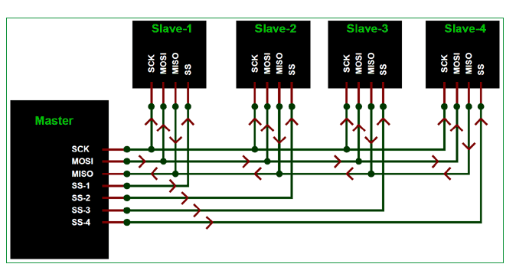
Synchronous Serial Protocols
Notes:
https://pdfs.semanticscholar.org/5f2a/4982a8adef2d1a6d589a155143291d440c0a.pdf

Slide 53
Synchronous Serial Protocols
I2C
Inter integrated circuit (I2C) two-line communication between different ICs or modules where two lines are SDA (Serial Data Line) and SCL (Serial Clock Line).
Both the lines must be connected to a positive supply using a pull up resistor.
I2C can deliver speed up to 400Kbps and it uses 10 bit or 7 bit addressing system to target a specific device on the i2c bus so it can connect up to 1024 devices.
It has limited length communication and is ideal for onboard communication.
I2C networks are easy to setup since it uses only two wires and new devices can simply be connected to the two common I2C bus lines. Same like SPI, microcontroller generally have I2C pins to connect any I2C device:
Notes:
https://pdfs.semanticscholar.org/5f2a/4982a8adef2d1a6d589a155143291d440c0a.pdf

Slide 54
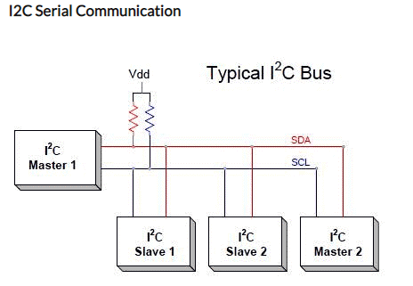
Synchronous Serial Protocols
Notes:
https://pdfs.semanticscholar.org/5f2a/4982a8adef2d1a6d589a155143291d440c0a.pdf

Slide 55
Synchronous Serial Protocols
3. USB
Universal Serial Bus is widely protocol with different versions and speeds.
A maximum of 127 peripherals can be connected to a single USB host controller.
USB acts as "plug and play" device.
The USB are used in almost devices such as keyboards, printers, media devices, cameras, scanners and mouse.
It is designed for easy installation, faster data rated, less cabling and hot swapping. It has replaced the bulkier and slower serial and parallel ports.
USB uses differential signalling to reduce interference and allow high-speed transmission over a long distance.
Notes:
https://pdfs.semanticscholar.org/5f2a/4982a8adef2d1a6d589a155143291d440c0a.pdf

Slide 56
Synchronous Serial Protocols
4. CAN
The Controller Area Network (CAN) is used in e.g. automotive to allow communication between ECUs (Engine Control Units) and sensors.
The CAN protocol is robust, low-cost and message based and covers in many applications - e.g. cars, trucks, tractors, industrial robots.
The CAN bus system allows for central error diagnosis and configuration across all ECUs.
CAN messages are prioritized via IDs so that the highest priority IDs are non-interrupted.
The CAN bus systems can provide speed up to 1Mbps.
Notes:
https://pdfs.semanticscholar.org/5f2a/4982a8adef2d1a6d589a155143291d440c0a.pdf

Slide 57
Asynchronous Serial Protocols
RS232 protocol
RS232 is the first serial protocol and was developed to connect modems to teletype machines. The RS stands for Recommended Standard and was initially put forth by the EIA (Electronic Industries Alliance).
With the RS2332 protocol, you can connect one transmitter to a single receiver.
The RS232 protocol supports cable lengths of up to 50 feet and provides the means to implement full-duplex transmission at baud rates of up to 1Mbps.
Serial ports can employ the RS232 protocol.
The standard RS232 serial port contains nine pins and can have either male or female connectors.
Notes:
https://www.serial-port-monitor.org/articles/serial-communication/types-of-serial-protocols/

Slide 58
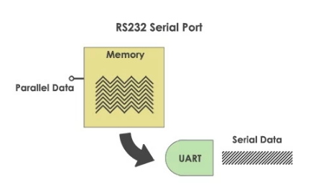
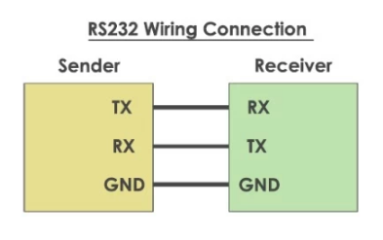
Asynchronous Serial Protocols
Notes:
https://pdfs.semanticscholar.org/5f2a/4982a8adef2d1a6d589a155143291d440c0a.pdf

Slide 59
Asynchronous Serial Protocols
2. RS422:
The RS422 protocol offers extended capability when implementing serial communication.
Up to ten transmitters and ten receivers can be connected through a single bus with this must-drop serial interface.
Data is transmitted using a differential configuration that employs two twisted-pair cables.
RS422 supports baud rates of up to 10Mbps with a maximum cable length of 4000 feet.
Notes:
https://pdfs.semanticscholar.org/5f2a/4982a8adef2d1a6d589a155143291d440c0a.pdf

Slide 60
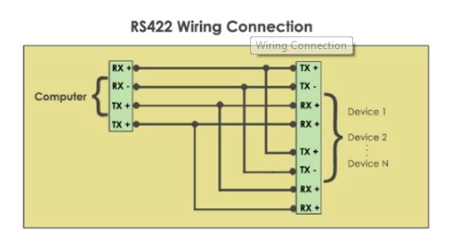
Asynchronous Serial Protocols
Notes:
https://pdfs.semanticscholar.org/5f2a/4982a8adef2d1a6d589a155143291d440c0a.pdf

Slide 61
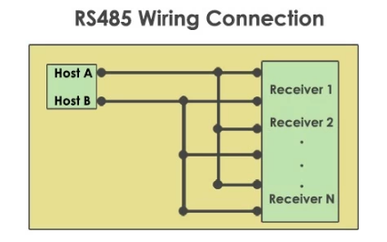
Asynchronous Serial Protocols
3. RS485:
The RS485 protocol is the preferred serial protocol used in industrial implementations. Using this protocol you can design a differential configuration that comprises up to 32 line drivers and 32 receivers. Only one transmitter can be active at any time and is known as the line driver.
Notes:
https://pdfs.semanticscholar.org/5f2a/4982a8adef2d1a6d589a155143291d440c0a.pdf

Slide 62
Daily Quiz
1. What is the speed of I2C bus?
100 kbits/s
10 kbits/s
75 kbits/s
100 kbits/s and 10 kbits/s
2. Are pull up registers required in I2C?
True
False

Slide 63
Daily Quiz
3. SPI device communicates in _________
Simplex
Half duplex
Full duplex
Both half and full duplex
4. How many logic signals are there in SPI?
5 signals
6 signals
4 signals
7 signal

Slide 64
Recap
Serial communication is usually accomplished using one of the two main serial protocols.
Synchronous Serial Protocols: SPI, I2C, CAN
b) Asynchronous Serial Protocols: RS232, RS422,RS485
These protocols support asynchronous data transfer and synchronous data transfer.

Slide 65
Introduction to Topic 5
Name of Topic | Objective of Topic | Mapping with CO
IoT Transmission Protocols | Students will be able to learn about Transmission Protocols used in IoT. | CO1

Slide 66
IoT Transmission Protocols
IoT protocols are a crucial part of the IoT technology stack. Without them, hardware would be rendered useless as the IoT protocols enable it to exchange data in a structured and meaningful way.
Interaction between sensors, devices, gateways, servers, and user applications is the essential characteristic that makes the Internet of Things what it is. But what enables all this smart stuff to talk and interact are the IoT protocols which can be seen as languages that the IoT gear uses in order to communicate.
IoT data protocols are used to connect low power IoT devices.
These protocols provide point-to-point communication with the hardware at the user side without any Internet connection. Connectivity in IoT data protocols is through a wired or a cellular network.
Some of the IoT data protocols are: CoAP, MQTT, XMPP, AMQP and M2M.

Slide 67
IoT Transmission Protocols: MQTT
MQTT (Message Queue Telemetry Transport) is a messaging protocol developed with the aid of Andy Stanford-Clark of IBM and Arlen Nipper of Arcom in 1999 and is designed for M2M communication. It’s normally used for faraway tracking in IoT.
Its primary challenge is to gather statistics from many gadgets and delivery of its infrastructure. MQTT connects gadgets and networks with packages and middleware.
All the devices hook up with facts concentrator servers like IBM’s new message sight appliance. MQTT protocols paintings on top of TCP to offer easy and dependable streams of information.
These IoT protocols include 3 foremost additives: subscriber, publisher, and dealer. The writer generates the information and transmits the facts to subscribers through the dealer. The dealer guarantees safety by means of move-checking the authorization of publishers and subscribers.

Slide 68
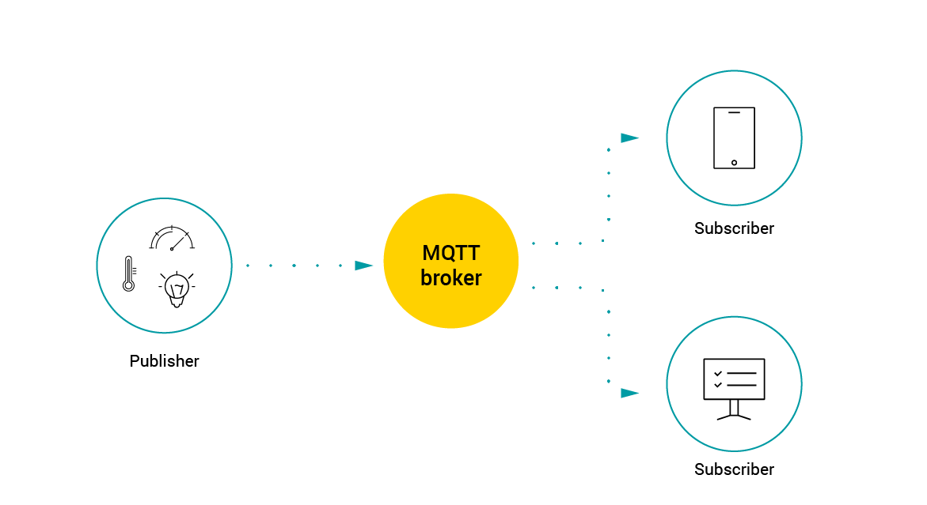
IoT Transmission Protocols: MQTT

Slide 69
IoT Transmission Protocols: CoAP
CoAP stands for Constrained Application Protocol
CoAP is an internet utility protocol for constrained gadgets.
It is designed to enable simple, constrained devices to join IoT through constrained networks having low bandwidth availability.
This protocol is primarily used for machine-to-machine (M2M) communication and is particularly designed for IoT systems that are based on HTTP protocols.
CoAP makes use of the UDP protocol for lightweight implementation. It also uses restful architecture, which is just like the HTTP protocol.

Slide 70
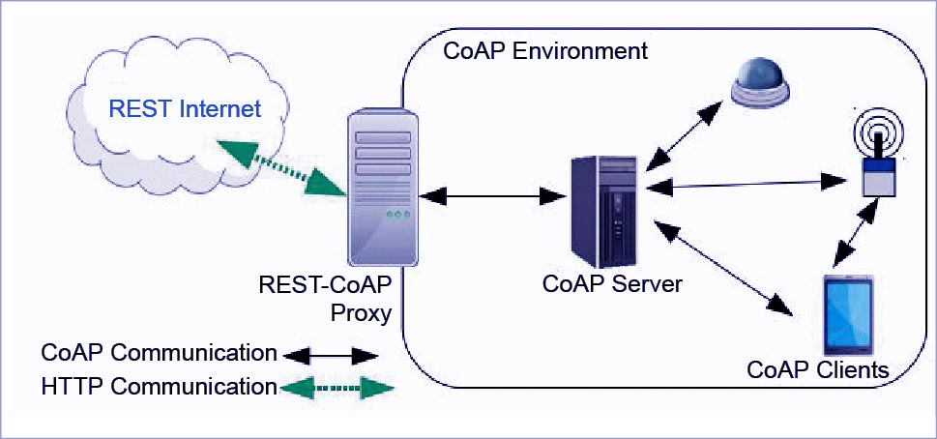
IoT Transmission Protocols: CoAP

Slide 71
IoT Transmission Protocols: XMPP
XMPP stands for Extensible Messaging and Presence Protocol
Developed in 1999 by the Jabber open source community and originally meant for real-time messaging, this communication IoT protocol for message-oriented middleware is based on the XML language.
It allows for real-time exchange of structured but extensible data between two or more network clients.
Being an open community supported standard, XMPP IoT’s strengths are addressing and scalability capabilities, which makes it perfect for consumer-oriented IoT deployments.
Among the drawbacks of using XMPP in IoT communication, it should be noted that it offers neither Quality of Service nor end-to-end encryption.

Slide 72
IoT Transmission Protocols: M2M
Machine-to-Machine (M2M) Communication Protocol
It is an open industry protocol built to provide remote application management of IoT devices.
M2M communication protocols are cost-effective and use public networks.
It creates an environment where two machines communicate and exchange data.
This protocol supports the self-monitoring of machines and allows the systems to adapt according to the changing environment.
M2M communication protocols are used for smart homes, automated vehicle authentication, vending machines, and ATM machines.

Slide 73
IoT Transmission Protocols: AMQP
AMQP stands for Advanced Message Queuing Protocol
This was evolved by John O’Hara at JP Morgan Chase in London.
AMQP is a software layer protocol for message-oriented middleware environment.
It supports reliable verbal exchange through message transport warranty primitives like at-most-once, at least once and exactly as soon as shipping.
The AMQP – IoT protocols consist of hard and fast components that route and save messages within a broker carrier, with a set of policies for wiring the components together.
The AMQP protocol enables patron programs to talk to the dealer and engage with the AMQP model.

Slide 74
IoT Transmission Protocols: AMQP
This version has the following three additives, which might link into processing chains in the server to create the favoured capabilities:
Exchange: Receives messages from publisher primarily based programs and routes them to ‘message queues’.
Message Queue: Stores messages until they may thoroughly process via the eating client software.
Binding: States the connection between the message queue and the change.

Slide 75
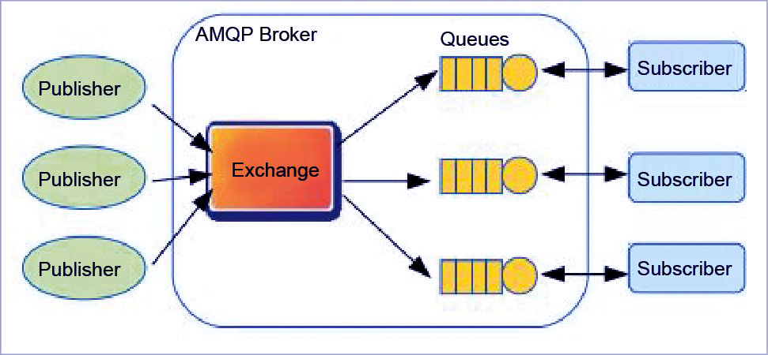
IoT Transmission Protocols: AMQP

Slide 76
Daily Quiz
What is a protocol?
Name any two IoT Protocols.
AMQP stands for____________.
Adjustable Message Queuing Protocol
Advanced Message Queuing Protocol
Application Message Queuing Protocol
Application Mailing Queue Protocol
4. _________ are the components of MQTT Protocol.
Subscriber
Broker
Publishers
All of the above

Slide 77
Daily Quiz
4. What is the standard form of SMQTT?
______ are the MQTT methods.
Connect, Disconnect
Subscribe, Unsubscribe
Publish
All of the above

Slide 78
Recap
IoT protocols are a crucial part of IoT technology. Without them, hardware would be rendered useless as IoT protocols enable it to exchange data in structured and meaningful way.
CoAP stands for Constrained Application Protocol. It is an internet utility protocol for constrained gadgets.
XMPP stands for Extensible Messaging and Presence Protocol. It allows for real-time exchange of structured but extensible data between two or more network clients.
AMQP is a software layer protocol for message-oriented middleware environment

Slide 79
Introduction to Topic 6
Name of Topic | Objective of Topic | Mapping with CO
Wired LAN Protocols | Students will be able to learn about Wired LAN protocols used in IoT. | CO3

Slide 80
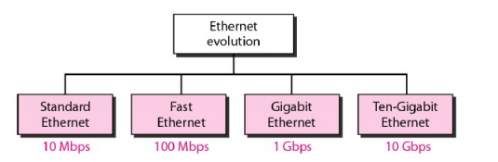
Wired LAN Protocols
The original Ethernet was created in 1976 at Xerox's Palo Alto Research Center (PARC). Since then, it has gone through four generations:
Standard Ethernet (10 Mbps)
Fast Ethernet (100 Mbps)
Gigabit Ethernet (1 Gbps)
Ten-Gigabit Ethernet (10 Gbps)
Notes:
https://pdfs.semanticscholar.org/5f2a/4982a8adef2d1a6d589a155143291d440c0a.pdf

Slide 81
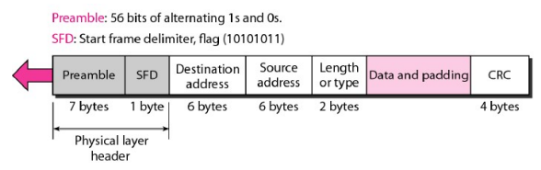
Wired LAN Protocols
Standard Ethernet(IEEE 802.3)
Standard Ethernet also known as IEEE 802.3 was the LAN standard proposed by IEEE.
Data rate for standard Ethernet is 10 Mbps.
In Standard Ethernet, the MAC sublayer governs the operation of the access method. It also frames data received from the upper layer and passes them to the physical layer.
Frame Format:
Notes:
https://pdfs.semanticscholar.org/5f2a/4982a8adef2d1a6d589a155143291d440c0a.pdf

Slide 82
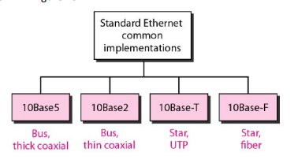
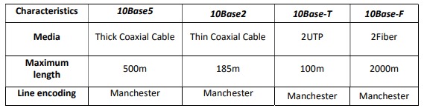
Wired LAN Protocols
Categories of Standard Ethernet:
Notes:
https://pdfs.semanticscholar.org/5f2a/4982a8adef2d1a6d589a155143291d440c0a.pdf

Slide 83
Wired LAN Protocols
Fast Ethernet(IEEE 802.3u)
Fast Ethernet was designed to compete with LAN protocols such as FDDI or Fiber Channel (or Fibre Channel, as it is sometimes spelled). IEEE created Fast Ethernet under the name 802.3u.
Fast Ethernet is backward-compatible with Standard Ethernet, but it can transmit data 10 times faster at a rate of 100 Mbps.
The goals of Fast Ethernet can be summarized as follows:
Upgrade the data rate to 100 Mbps.
Make it compatible with Standard Ethernet.
Keep the same 48-bit address.
Keep the same frame format.
Keep the same minimum and maximum frame lengths
Notes:
https://pdfs.semanticscholar.org/5f2a/4982a8adef2d1a6d589a155143291d440c0a.pdf

Slide 84
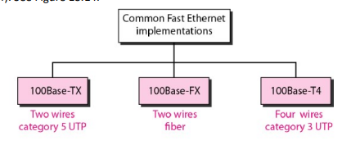
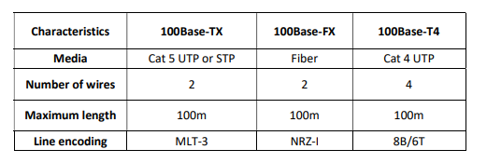
Wired LAN Protocols
Categories of Fast Ethernet:
Notes:
https://pdfs.semanticscholar.org/5f2a/4982a8adef2d1a6d589a155143291d440c0a.pdf

Slide 85
Wired LAN Protocols
Gigabit Ethernet(IEEE 802.3z)
The need for an even higher data rate resulted in the design of the Gigabit Ethernet protocol (1000 Mbps). The IEEE committee calls the Standard 802.3z.
The goals of the Gigabit Ethernet design can be summarized as follows:
Upgrade the data rate to 1 Gbps.
Make it compatible with Standard or Fast Ethernet.
Use the same 48-bit address.
Use the same frame format.
Keep the same minimum and maximum frame lengths.
Notes:
https://pdfs.semanticscholar.org/5f2a/4982a8adef2d1a6d589a155143291d440c0a.pdf

Slide 86
Wired LAN Protocols
4. Ten-Gigabit Ethernet(IEEE 802.3ae)
The IEEE committee created Ten-Gigabit Ethernet and called it Standard 802.3ae.
The goals of the Ten-Gigabit Ethernet design can be summarized as follows:
Upgrade the data rate to 10 Gbps.
Make it compatible with Standard, Fast, and Gigabit Ethernet.
Use the same 48-bit address.
Use the same frame format.
Keep the same minimum and maximum frame lengths.
Allow the interconnection of existing LANs into a metropolitan area network (MAN) or a wide area network (WAN).
Make Ethernet compatible with technologies such as Frame Relay and ATM.
Ten-Gigabit Ethernet operates only in full duplex mode which means there is no need for contention.
Notes:
https://pdfs.semanticscholar.org/5f2a/4982a8adef2d1a6d589a155143291d440c0a.pdf

Slide 87
Daily Quiz
1. Ethernet frame consists of ____________.
MAC address
IP address
Default mask
Network address
2. Ethernet in metropolitan area network (MAN) can be used as___________.
pure ethernet
ethernet over SDH
ethernet over MPLS
all of the mentioned

Slide 88
Daily Quiz
3. An Ethernet frame that is less than the IEEE 802.3 minimum length of 64 octets is called _______.
short frame
runt frame
mini fram
man frame
4. Which of the following standard is followed by the Ethernet ?
IEEE 802.10
IEEE 802.11
IEEE 802.5
IEEE 802.3

Slide 89
Recap
The original Ethernet has gone through four generations:
Standard Ethernet (10 Mbps)
Fast Ethernet (100 Mbps)
Gigabit Ethernet (1 Gbps)
Ten-Gigabit Ethernet (10 Gbps)
Notes:
https://pdfs.semanticscholar.org/5f2a/4982a8adef2d1a6d589a155143291d440c0a.pdf

Slide 90
Introduction to Topic 6
Name of Topic | Objective of Topic | Mapping with CO
Features and security in Bluetooth | Students will be able to learn about the features and security in Bluetooth. | CO3

Slide 91
Features and Security in Bluetooth
Bluetooth allows two devices to be connected to each other wirelessly.
The most common use of Bluetooth technology is in hands-free devices such as headsets used with mobile phones.
Bluetooth technology can also be used to transfer data between two electronics devices without using wires.
Features:
Bluetooth technology uses radio waves to send information between two devices that are close to each other.
Unlike traditional radio waves, Bluetooth waves typically can only travel 33 feet or less.
Notes:
https://pdfs.semanticscholar.org/5f2a/4982a8adef2d1a6d589a155143291d440c0a.pdf

Slide 92
Features and Security in Bluetooth
Security:
Bluetooth security is of paramount importance as devices are susceptible to a variety of wireless and networking attacking including denial of service attacks, eavesdropping, man-in-the-middle attacks, message modification, and resource misappropriation.
Bluetooth security must also address more specific Bluetooth related attacks that target known vulnerabilities in Bluetooth implementations and specifications.
These may include attacks against improperly secured Bluetooth implementations which can provide attackers with unauthorized access.
There are three basic means of providing Bluetooth security:
Authentication
Confidentiality
Authorization
Notes:
https://pdfs.semanticscholar.org/5f2a/4982a8adef2d1a6d589a155143291d440c0a.pdf

Slide 93
Daily Quiz
Bluetooth is the wireless technology for __________
local area network
Personal area network
metropolitan area network
wide area network
2. Bluetooth uses __________
frequency hopping spread spectrum
orthogonal frequency division multiplexing
time division multiplexing
channel division multiplexing

Slide 94
Daily Quiz
3. Bluetooth supports _______
point-to-point connections
point-to-multipoint connection
both point-to-point connections and point-to-multipoint connection
multipoint to point connection
4. Unauthorised access of information from a wireless device through a bluetooth connection is called _________
Bluemaking
bluesnarfing
Bluestring
bluescoping

Slide 95
Features and Security in Bluetooth
Bluetooth allows two devices to be connected to each other wirelessly.
The most common use of Bluetooth technology is in hands-free devices such as headsets used with mobile phones.
Bluetooth technology can also be used to transfer data between two electronics devices without using wires.
Features:
Bluetooth technology uses radio waves to send information between two devices that are close to each other.
Unlike traditional radio waves, Bluetooth waves typically can only travel 33 feet or less.
Notes:
https://pdfs.semanticscholar.org/5f2a/4982a8adef2d1a6d589a155143291d440c0a.pdf

Slide 96
Recap
Bluetooth allows two devices to be connected to each other wirelessly.
The most common use of Bluetooth technology is in hands-free devices such as headsets used with mobile phones
There are three basic means of providing Bluetooth security:
Authentication
Confidentiality
Authorization
Notes:
https://pdfs.semanticscholar.org/5f2a/4982a8adef2d1a6d589a155143291d440c0a.pdf

Slide 97
Weekly Assignment 1
Write short note on IoT connectivity.
What are the various IoT Communication technologies?
Explain various WAN protocols used in IoT.
Explain the various layers of X.25 protocol.
Explain the various LAN protocols.
Write short note on:
Etherent
Token Ring
FDDI
7. Write short note on:
Frame Relay
X.25
Services Digital Network (ISDN)
Point-to-Point Protocol (PPP)
HDLC

Slide 98
Weekly Assignment 2
Explain the various Serial Communication Protocols.
What are the various IoT transmission Protocols used in IoT?
Differentiate between synchronous and asynchronous communication protocols
What are the various Wired LAN Protocols used in IoT?
Write short note on Bluetooth.
Write down the various features of Bluetooth.
Write short note on: Security in Bluetooth
Write short note on:
AMQP
XMPP
MQTT

Slide 99
Topic Links
IoT Connectivity -An Overview
https://www.youtube.com/watch?v=7vl07f16h-g
WAN Protocols
https://www.youtube.com/watch?v=wSKMFECN8DM
LAN Protocols
https://www.youtube.com/watch?v=ffM6dsTtX9Q
Serial Protocols
https://circuitdigest.com/tutorial/serial-communication-protocols
IoT transmission Protocols
https://www.youtube.com/watch?v=_gMZiF86gdw
Wired LAN Protocols
https://new.bhu.ac.in/Images/files/Lecture%20Notes%20Wired%20LANs%20Ethernet.pdf
Features and Security in Bluetooth
https://www.youtube.com/watch?v=sCxaTZIqxlA

Slide 100
MCQ’s
1. What is the speed of I2C bus?
100 kbits/s
10 kbits/s
75 kbits/s
100 kbits/s and 10 kbits/s
2. Are pull up registers required in I2C?
True
False

Slide 101
MCQ’s
3. SPI device communicates in _________
Simplex
Half duplex
Full duplex
Both half and full duplex
4. How many logic signals are there in SPI?
5 signals
6 signals
4 signals
7 signal

Slide 102
MCQ’s
5. FDDI is ____.
Ring network
Star network
Mesh network
Bus based network
6. Which of the following is not a field in the Ethernet message packet?
Type
Data
Pin-code
Address

Slide 103
MCQ’s
7. Which of the following standard is followed by the Ethernet ?
IEEE 802.10
IEEE 802.11
IEEE 802.5
IEEE 802.3
8. Which of the following is an IEEE project 802 standard ?
Token bus
Token ring
Ethernet
All of the above

Slide 104
MCQ’s
9. Bluetooth is the wireless technology for __________
local area network
Personal area network
metropolitan area network
wide area network
10. Bluetooth uses __________
frequency hopping spread spectrum
orthogonal frequency division multiplexing
time division multiplexing
channel division multiplexing

Slide 105
MCQ’s
11. Bluetooth supports _______
point-to-point connections
point-to-multipoint connection
both point-to-point connections and point-to-multipoint connection
multipoint to point connection
12. Unauthorised access of information from a wireless device through a bluetooth connection is called _________
Bluemaking
bluesnarfing
Bluestring
bluescoping

Slide 106
MCQ’s
13. What is the speed of I2C bus?
100 kbits/s
10 kbits/s
75 kbits/s
100 kbits/s and 10 kbits/s
14. Are pull up registers required in I2C?
True
False

Slide 107
Glossary Questions
(CoAP, HDLC, Bluetooth, Sensors, Protocol abstraction)
___________ allows two devices to be connected to each other wirelessly.
_____ is used to capture data from the physical world in IoT devices.
IoT gateway must provide __________.
________ is an internet utility protocol for constrained gadgets.
is a connection-oriented protocol at the Data Link layer, but it has very little overhead compared to LAPB.
(Answer: Bluetooth, Sensors, Protocol abstraction, CoAP, HDLC)

Slide 108
Old Question Paper

Slide 109
Expected Questions
Differentiate between synchronous and asynchronous communication protocols
What are the various Wired LAN Protocols used in IoT?
Write short note on Bluetooth.
Write down the various features of Bluetooth.
Write short note on: Security in Bluetooth
Explain the concept of IoT.
What are the various IoT Communication technologies?
Explain various WAN protocols used in IoT.
Explain the various layers of X.25 protocol.
Explain the various LAN protocols.
Write short note on:
Etherent
Token Ring
FDDI

Slide 110
Recap Of Unit
In this Unit, we have describe the basic concepts of connecting IoT devices and how protocols are used in IoT
Various types of protocols like Wireless Long Range (WAN) Protocols, LAN Protocols, Serial Protocols, IoT transmission Protocols, Wired LAN Protocols are discussed in this unit.
Here, we have also discussed various features of bluetooth and how security is achieved in Bluetooth.

Slide 111
Thank YOU

